Slide 1

Topic
Manchester United Football Club

Slide 2
1) Introduction
Manchester United Football Club, commonly referred to as Man United (often stylised as Man Utd), or simply United, is a professional football club based in Old Trafford, Greater Manchester, England. The club competes in the Premier League, the top division in the English football league system. Nicknamed the Red Devils, it was founded as Newton Heath LYR Football Club in 1878, but changed its name to Manchester United in 1902. The club moved from Newton Heath to its current stadium, Old Trafford, in 1910.
Manchester United have won a record 20 League titles, 12 FA Cups, five League Cups, and a record 21 FA Community Shields. They have won the European Cup/UEFA Champions League three times, and the UEFA Europa League, the UEFA Cup Winners' Cup, the UEFA Super Cup, the Intercontinental Cup and the FIFA Club World Cup once each.
That is why they are known as one of the biggest football club in the world.

Slide 3
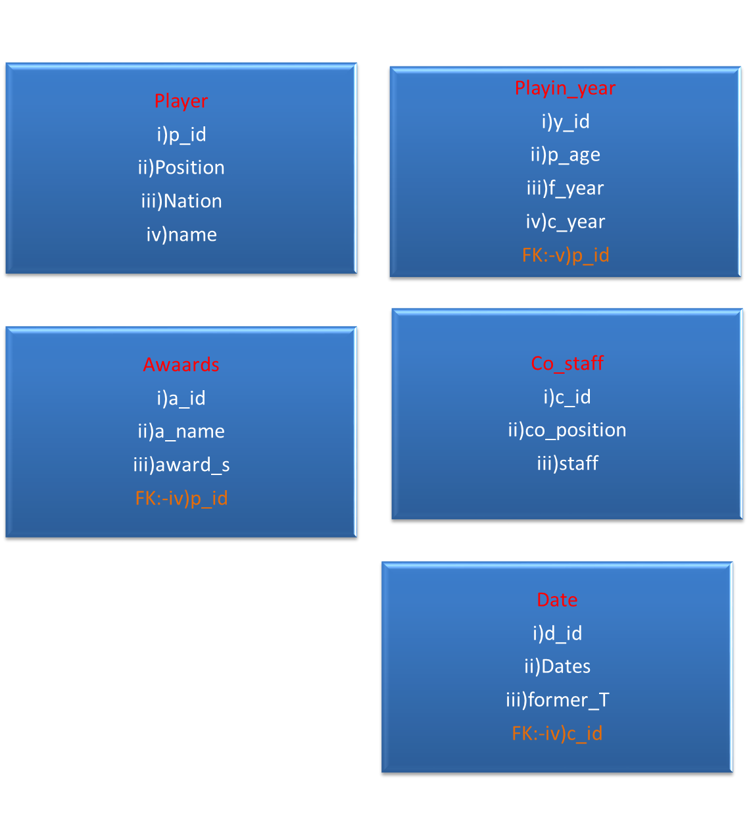
2) ER Diagram

Slide 4
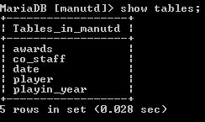
3.DATABASE DESIGN
DATABASE : Manchester United FC
Tables :-
a) Player.
b) Playin_year.
c) Co_staff.
d) Date.
e) Awards. Show tables;

Slide 5
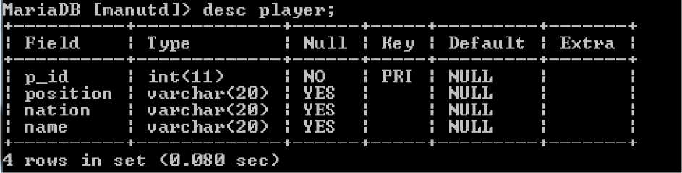
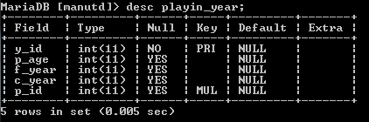
a) Player. Desc player;
b) Playin_year.
Desc Playin_year;

Slide 6
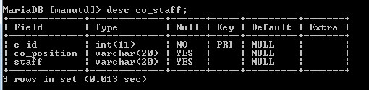
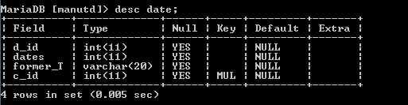
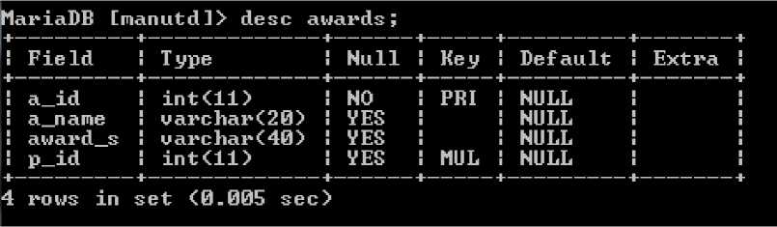
c) Co_staff.
Desc Co_staff;
d) Date.
Des Date;
e) Awards. Desc Awards;

Slide 7
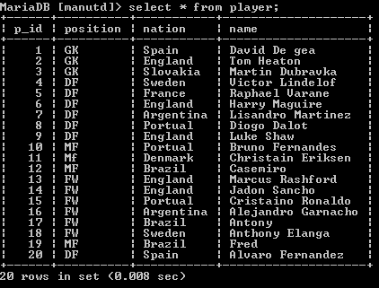
Tables
a) player.
Select * from player;

Slide 8
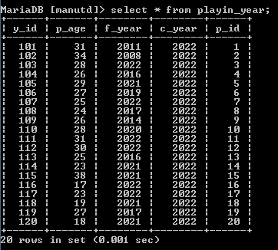
b) Playin_date .
Select * from playin_date;

Slide 9
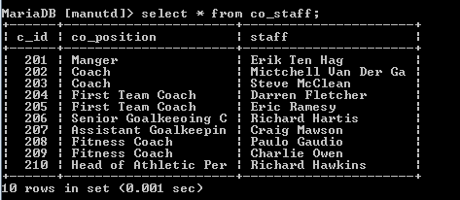
c) Co_staff.
Select * from co_staff;

Slide 10
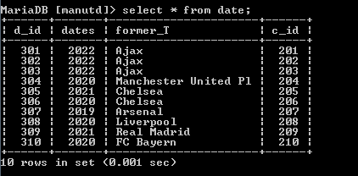
d) Date.
Select * from date;

Slide 11
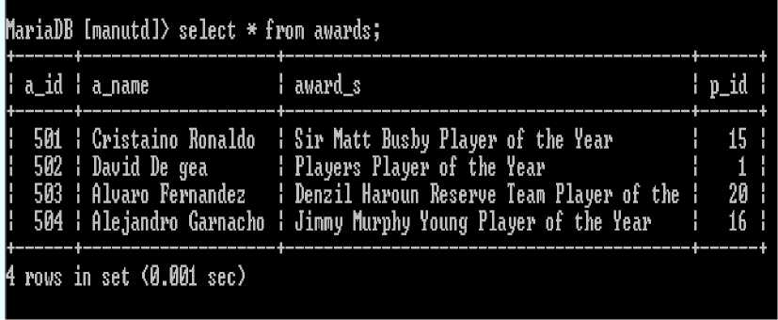
e) Awards.
Select * from awards;

Slide 12
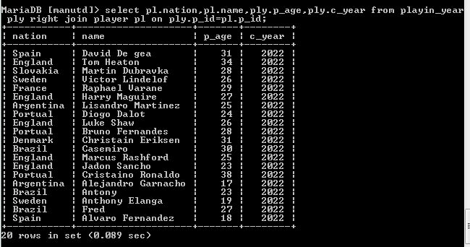
3) Joins
i) select pl.nation,pl.name,ply.p_age,ply.c_year from playin_year ply right join player pl on ply.p_id=pl.p_id;

Slide 13
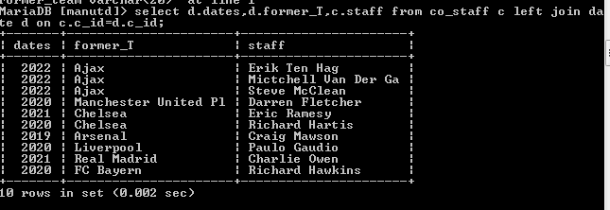
ii) select d.dates,d.former_T,c.staff from co_staff c left join date d on c.c_id=d.c_id;

Slide 14
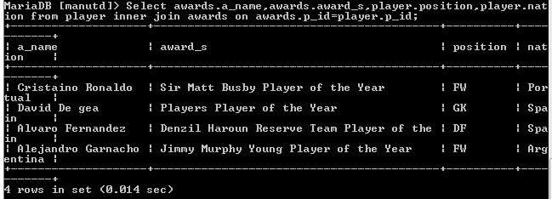
iii) select
awards.a_name,awards.award_s,player.position,player.natio n from player inner join awards on awards.p_id=player.p_id;

Slide 15
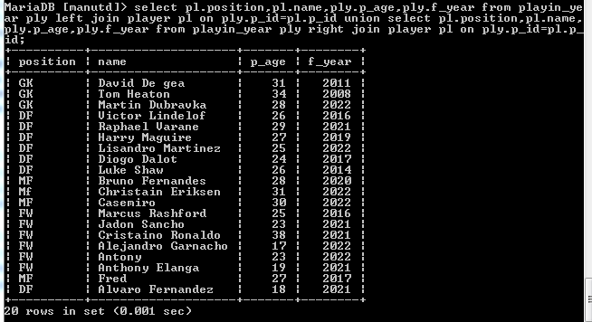
iv) select pl.position,pl.name,ply.p_age,ply.f_year from playin_year ply right join player pl on ply.p_id=pl.p_id union
select pl.position,pl.name,ply.p_age,ply.f_year from playin_year ply right join player pl on ply.p_id=pl.p_id;

Slide 16
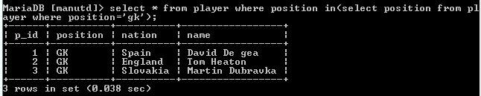
4) Sub-querys
i) select * from player where position in(select position from player where ion='gk');

Slide 17
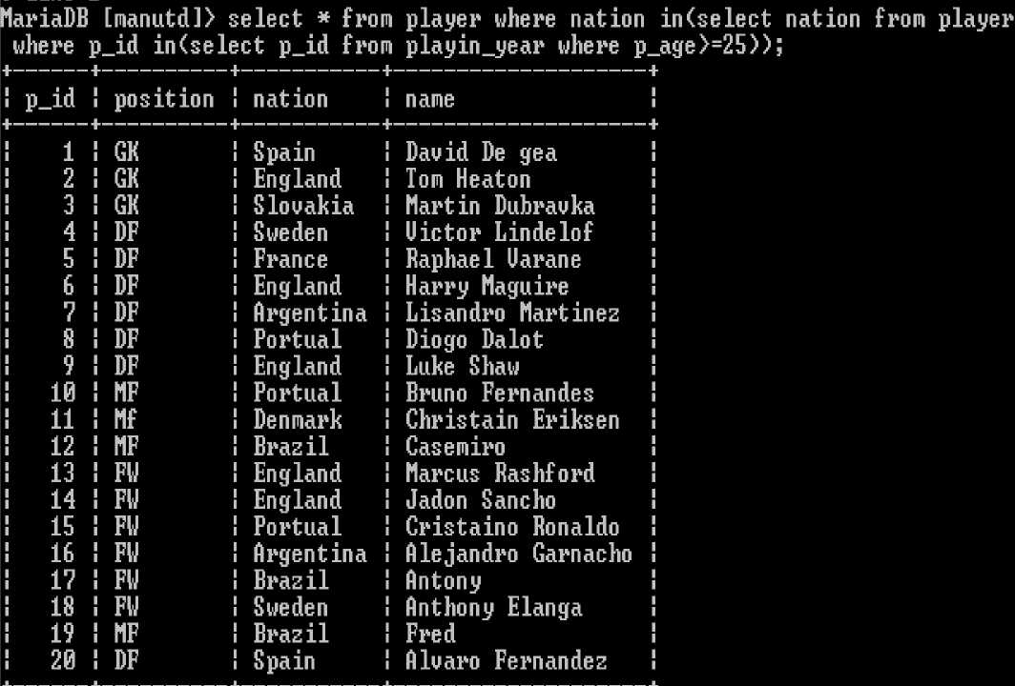
ii) select * from player where nation in(select nation from player where p_id in(select p_id from playin_year where p_age>=25) );
20 rows in set <0.041 sec)

Slide 18
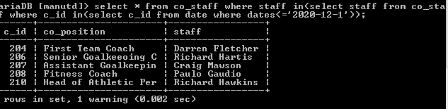
iii) select * from co_staff where staff in(select staff from co_staff where c_id in(select c_id from date where dates='2021-12-1') );

Slide 19
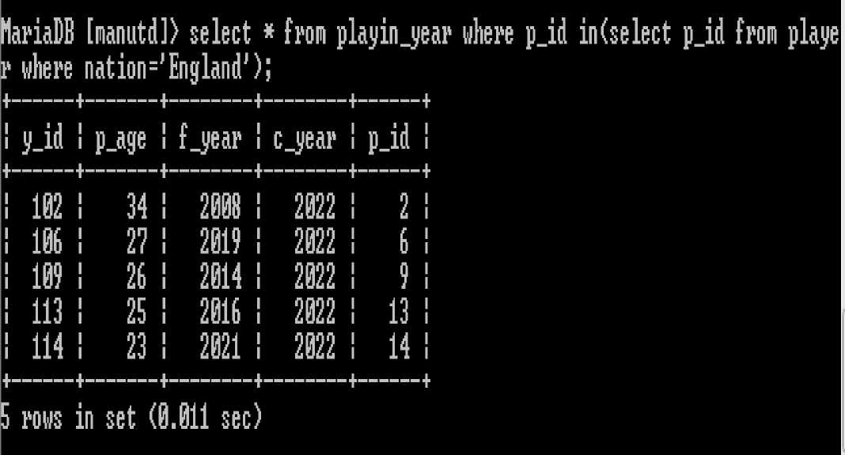
iv) select * from playin_year where p_id in(select p_id from player where nation='England');

Slide 20
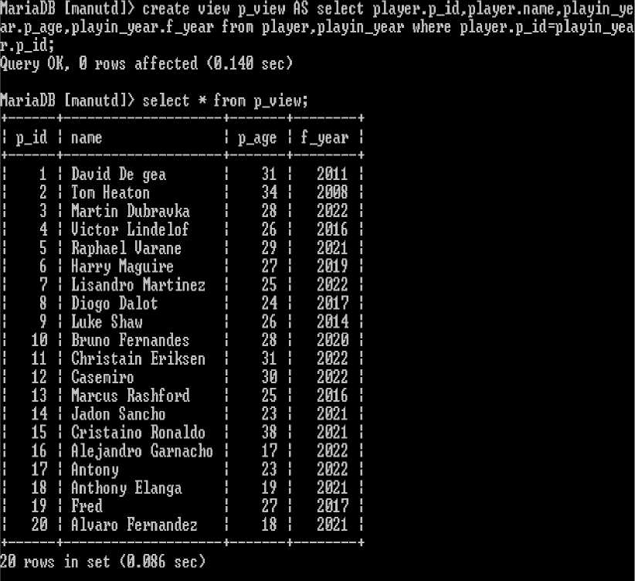
5) View
*) create view
p_viewAS selectplayer. p_id,player. name,playin_year. p_age,playin_yea r.f_year from player,playin_year where player.p_id=playin_year.p_id;

